Slide 1
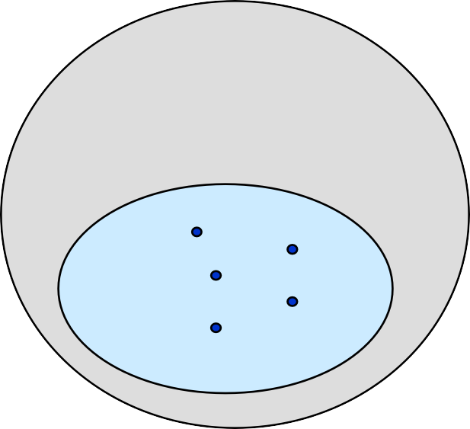
Hash Tables
0
U
(universe of keys)
h(k₁)
h(k₄)
K
k₁
(actual
k₄
k₂
collision
h(k₂)=h(k₅)
keys)
k
k
5
3
h(k₃)
m–1
Lecturer Saifur Rahman, Dept. of CSE, United International University

Slide 2
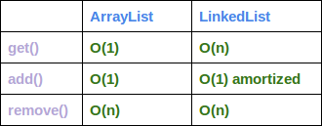
Lecturer Saifur Rahman, Dept. of CSE, United International University

Slide 3



Dictionary
Dictionary:
Dynamic-set data structure for storing items indexed using
keys.
Supports operations Insert, Search, and Delete. Applications:
Symbol table of a compiler.
Memory-management tables in operating systems. Large-scale distributed systems.
Hash Tables:
Effective way of implementing dictionaries. Generalization of ordinary arrays.
Lecturer Saifur Rahman, Dept. of CSE, United International University

Slide 4


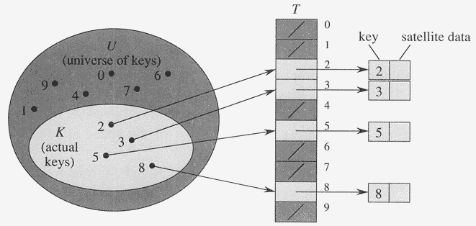
Direct-Address Tables
Direct-address Tables are ordinary arrays Facilitate direct addressing
Element whose key is k is obtained by indexing into the k^{th} position of the array
Applicable when we can afford to allocate an array with one
position for every possible key
i.e. when the universe of keys U is small
Dictionary operations can be implemented to take O(1) time

Slide 5
Direct-Address Tables
Suppose:
The range of keys is 0..m-1 Keys are distinct
The idea:
Set up an array T[0..m-1] in which
T[i] = x
T[i] = NULL
if x∈ T and key[x] = i
otherwise
This is called a direct-address table
Operations take O(1) time !
So what’s the problem?
Lecturer Saifur Rahman, Dept. of CSE, United International University

Slide 6
Direct-Address Tables
Direct addressing works well when the range m of keys is relatively small
But what if the keys are 32-bit integers? Problem 1: direct-address table will have 2³² entries, more than 4 billion
Problem 2: even if memory is not an issue, the time to initialize the elements to NULL may be
Solution: map keys to smaller range 0..m-1 This mapping is called a hash function
Lecturer Saifur Rahman, Dept. of CSE, United International University

Slide 7

Hash Tables
Motivation: symbol tables
A compiler uses a symbol table to relate symbols to associated data
Symbols: variable names, procedure names, etc.
Associated data: memory location, call graph, etc.
For a symbol table (also called a dictionary), we care about search, insertion, and deletion
We want these to be fast, but don’t care about sorted order
The structure we will use is a hash table
Supports all the above in O(1) expected time !
Lecturer Saifur Rahman, Dept. of CSE, United International University

Slide 8
Hash Tables
Notation:
U : Universe of all possible keys.
K : Set of keys actually stored in the dictionary.
|K| = n.
When U is very large,
Arrays are not practical.
|K| << |U|.
Use a table of size proportional to |K| – The hash tables.
However, we lose the direct-addressing ability.
Define functions that map keys to slots of the hash table.
Lecturer Saifur Rahman, Dept. of CSE, United International University

Slide 9
Hashing
Hash function h: Mapping from U to the slots of a hash table T[0..m–1].
h : U → {0,1,…, m–1}
With arrays, key k maps to slot A[k].
With hash tables, key k maps or “hashes” to slot T[h[k]]. h[k] is the hash value of key k.
Lecturer Saifur Rahman, Dept. of CSE, United International University

Slide 10
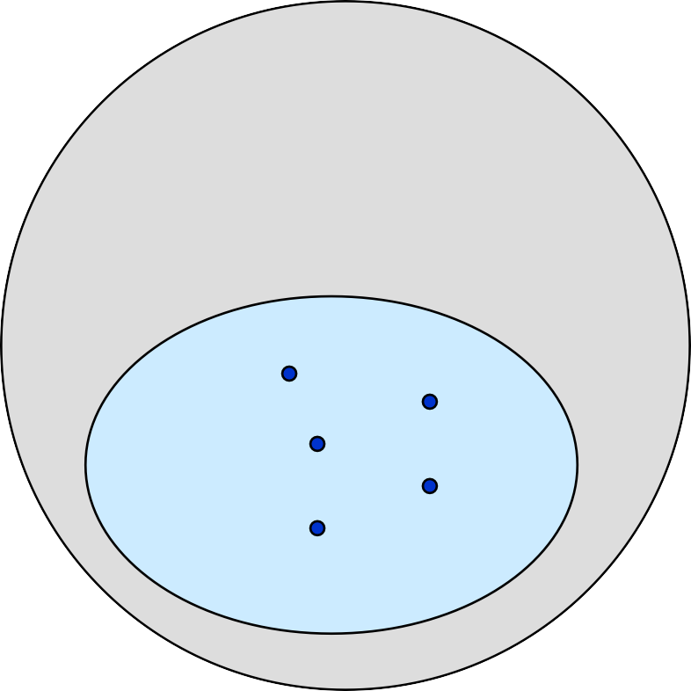
Hashing
0
U
(universe of keys)
h(k₁)
h(k₄)
k₁
k₂
K
(actual keys)
k₄
collision
h(k₂)=h(k₅)
k₅
k₃
h(k₃)
m–1
Lecturer Saifur Rahman, Dept. of CSE, United International University

Slide 11
Issues with Hashing
Multiple keys can hash to the same slot – collisions are possible.
Design hash functions such that collisions are minimized. But avoiding collisions is impossible.
Design collision-resolution techniques.
Search will cost Ө(n) time in the worst case.
However, all operations can be made to have an expected
complexity of Ө(1).
Lecturer Saifur Rahman, Dept. of CSE, United International University

Slide 12


Methods of Resolution
Chaining:
Store all elements that hash to the same slot in
a linked list.
Store a pointer to the head of the linked list in the hash table slot.
Open Addressing:
All elements are stored in hash table itself. When collisions occur, use a systematic
(consistent) procedure to store elements in free slots of the table.
0
k₁
k₄
k₅
k₂
k₆
k
7
k₃
k
8
m–1
Lecturer Saifur Rahman, Dept. of CSE, United International University

Slide 13
Methods of Resolution
Chaining:
Store all elements that hash to the same slot in
a linked list.
Store a pointer to the head of the linked list in the hash table slot.
Open Addressing:
All elements are stored in hash table itself. When collisions occur, use a systematic
(consistent) procedure to store elements in free slots of the table.
0
k₁
k₄
k₅
k₂
k₆
k
7
k₃
k
8
m–1
Lecturer Saifur Rahman, Dept. of CSE, United International University

Slide 14
Methods of Resolution
Chaining:
Store all elements that hash to the same slot in
a linked list.
Store a pointer to the head of the linked list in the hash table slot.
Open Addressing:
All elements are stored in hash table itself. When collisions occur, use a systematic
(consistent) procedure to store elements in free slots of the table.
0
k₁
k₄
k₅
k₂
k₆
k
7
k₃
k
8
m–1
Lecturer Saifur Rahman, Dept. of CSE, United International University

Slide 15
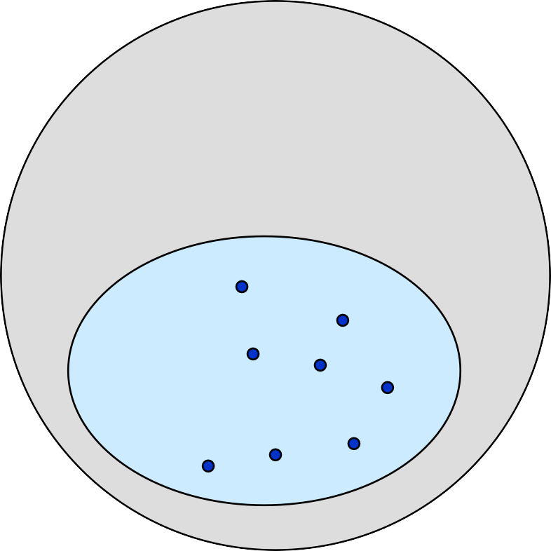
Collision Resolution by Chaining
0
U
(universe of keys)
h(k₁)=h(k₄)
X
k₁
k₄
K
(actual k₂
keys)
k₆
X
h(k₂)=h(k₅)=h(k₆)
k
5
k₈
k₇
k₃
X
h(k₃)=h(k₇)
h(k₈) m–1
Lecturer Saifur Rahman, Dept. of CSE, United International University

Slide 16
Collision Resolution by Chaining
Chaining puts elements that hash to the same slot in a linked list:
0
U
(universe of keys)
k₁
k₄
k₁
k₄
K
(actual k₂
keys)
k
k₆
k₅
k₂
k₆
5
k₈
k₇
k₃
k₇
k₃
k₈
m–1
Lecturer Saifur Rahman, Dept. of CSE, United International University

Slide 17

Chaining
How do we insert an element?
T
U
(universe of keys)
——
k₁
k₄
——
——
k₁
——
K
(actual keys)
k₄
k₅
——
k₇
k₅
k₂
k₇
——
——
k₂
k₃
k₃ | ——
k₈
k
k₆
8
k₆
——
Lecturer Saifur Rahman, Dept. of CSE, United International University

Slide 18
Chaining
How do we delete an element?
T
U
(universe of keys)
——
k₁
k₄
——
——
k₁
——
K
(actual keys)
k₄
k₅
——
k₇
k₅
k₂
k₇
——
——
k₂
k₃
k₃ | ——
k₈
k
k₆
8
k₆
——
Lecturer Saifur Rahman, Dept. of CSE, United International University

Slide 19
Chaining
How do we search for a element with a given key?
T
U
(universe of keys)
——
k₁
k₄
——
——
k₁
——
K
(actual keys)
k₄
k₅
——
k₇
k₅
k₂
k₇
——
——
k₂
k₃
k₃ | ——
k₈
k
k₆
8
k₆
——
Lecturer Saifur Rahman, Dept. of CSE, United International University

Slide 20
Chaining Example
ℎ 𝑘 = 2𝑘%5
keys:
2, 15, 23, 40, 62, 75
Lecturer Saifur Rahman, Dept. of CSE, United International University

Slide 21
Analysis of Chaining
Assume simple uniform hashing: each key in table is equally likely to be hashed to any slot
Given n keys and m slots in the table: the
load factor α = n/m = average # keys per slot
What will be the average cost of an unsuccessful search for a key?
Lecturer Saifur Rahman, Dept. of CSE, United International University

Slide 22
Analysis of Chaining
Assume simple uniform hashing: each key in table is equally likely to be hashed to any slot
Given n keys and m slots in the table, the
load factor α = n/m = average # keys per slot
What will be the average cost of an unsuccessful search
for a key?
A: O(1+α)
Lecturer Saifur Rahman, Dept. of CSE, United International University

Slide 23
Analysis of Chaining
Assume simple uniform hashing: each key in table is equally likely to be hashed to any slot
Given n keys and m slots in the table, the
load factor α = n/m = average # keys per slot
What will be the average cost of an unsuccessful search
for a key?
A: O(1+α)
What will be the average cost of a successful search?
Lecturer Saifur Rahman, Dept. of CSE, United International University

Slide 24
Analysis of Chaining
Assume simple uniform hashing: each key in table is equally likely to be hashed to any slot
Given n keys and m slots in the table, the
load factor α = n/m = average # keys per slot
What will be the average cost of an unsuccessful search
for a key?
A: O(1+α)
What will be the average cost of a successful search?
A: O(1 + α/2) = O(1 + α)
Lecturer Saifur Rahman, Dept. of CSE, United International University

Slide 25
Analysis of Chaining
Draw the 11-item hash table that results from using the hash function h(k) = (2k + 5) mod 11, to hash the keys 12, 44, 13, 88, 23, 94, 11, 39, 20, 16, and 5,
assuming collisions are handled by chaining.
Lecturer Saifur Rahman, Dept. of CSE, United International University

Slide 26
Analysis of Chaining
Draw the 11-item hash table that results from using the hash function h(k) = (2k + 5) mod 11, to hash the keys 12, 44, 13, 88, 23, 94, 11, 39, 20, 16, and 5,
assuming collisions are handled by chaining.
Lecturer Saifur Rahman, Dept. of CSE, United International University

Slide 27
Open Addressing
Basic idea:
To insert: if slot is full, try another slot, …, until an open
slot is found (probing)
To search, follow same sequence of probes as would be used when inserting the element
If reach element with correct key, return it
If reach a NULL pointer, element is not in table
Good for fixed sets (adding but no deletion)
Example: spell checking
Table needn’t be much bigger than n
Lecturer Saifur Rahman, Dept. of CSE, United International University

Slide 28


Probe Sequence
Sequence of slots examined during a key search constitutes a
probe sequence.
Probe sequence must be a permutation of the slot numbers.
We examine every slot in the table, if we have to.
We don’t examine any slot more than once.
The hash function is extended to:
h : U × {0, 1, …, m – 1} → {0, 1, …, m – 1}
probe number slot number
⟨h(k, 0), h(k, 1),…,h(k, m – 1)⟩ should be a permutation of
⟨0, 1,…, m – 1 ⟩.
Lecturer Saifur Rahman, Dept. of CSE, United International University

Slide 29

Computing Probe Sequences
The ideal situation is uniform hashing:
Generalization of simple uniform hashing.
Each key is equally likely to have any of the m! permutations of
⟨0, 1,…, m – 1⟩ as its probe sequence.
It is hard to implement true uniform hashing.
Approximate with techniques that at least guarantee that the probe sequence is a permutation of ⟨0, 1,…, m – 1⟩.
Some techniques:
Use auxiliary hash functions.
Linear Probing. Quadratic Probing. Double Hashing.
Can’t produce all m! probe sequences.
Lecturer Saifur Rahman, Dept. of CSE, United International University

Slide 30
Linear Probing
h(k, i) = (h′(k) + i) mod m.
key Probe number Auxiliary hash function
The initial probe determines the entire probe sequence.
T[h′(k)], T[h′(k)+1], …, T[m–1], T[0], T[1], …, T[h′(k)–1]
Hence, only m distinct probe sequences are possible.
Suffers from primary clustering:
Long runs of occupied sequences build up.
Long runs tend to get longer, since an empty slot preceded by i
full slots gets filled next with probability (i+1)/m.
Hence, average search and insertion times increase.
Lecturer Saifur Rahman, Dept. of CSE, United International University

Slide 31
Ex: Linear Probing
Example:
h'(k) = k mod 13
h(k, i) = (h'(k) + i) mod 13
Insert keys 18, 41, 22, 44, 59, 32, 31, 73, in this order
0 1 2 3 4 5 6 7 8 9 10 11 12
 |  | 41 |  |  | 18 | 44 | 59 | 32 | 22 | 31 | 73
0 1 2 3 4 5 6 7 8 9 10 11 12
Lecturer Saifur Rahman, Dept. of CSE, United International University

Slide 32
Operation Insert
Act as though we were searching, and insert at the first NIL slot found.
Hash-Insert(T, k)
i ← 0
repeat j ← h(k, i)
3.
4.
5.
6.
if T[j] = NIL
then T[j] ← k
return j
else i ← i + 1
until i = m
error “hash table overflow”
Lecturer Saifur Rahman, Dept. of CSE, United International University

Slide 33
Pseudo-code for Search
Hash-Search (T, k)
i ← 0
repeat j ← h(k, i)
3.
4.
5.
if T[j] = k
then return j
i ← i + 1
until T[j] = NIL or i = m
return NIL
Lecturer Saifur Rahman, Dept. of CSE, United International University

Slide 34
Example:
h'(k) = k mod 13
h(k, i) = (h'(k) + i) mod 13
Insert keys 17,30,43 in this order; delete 30; search 43;
Lecturer Saifur Rahman, Dept. of CSE, United International University

Slide 35
Deletion
Cannot just turn the slot containing the key we want to delete to contain NIL. Why?
Use a special value DELETED instead of NIL when marking a slot as empty during deletion.
Search should treat DELETED as though the slot holds a key
that does not match the one being searched for.
Insert should treat DELETED as though the slot were empty, so that it can be reused.
Disadvantage: Search time is no longer dependent on α.
Hence, chaining is more common when keys have to be deleted.
Lecturer Saifur Rahman, Dept. of CSE, United International University

Slide 36
Quadratic Probing
h(k, i) = (h′(k) + c₁i + c₂i²) mod m
key Probe number Auxiliary hash function
c₁≠ c₂
The initial probe position is T[h′(k)], later probe positions are offset by amounts that depend on a quadratic function of the probe number i.
Must constrain c₁, c₂, and m to ensure that we get a full permutation of ⟨0, 1,…, m – 1⟩.
Can suffer from secondary clustering:
If two keys have the same initial probe position, then their probe sequences are the same.
Lecturer Saifur Rahman, Dept. of CSE, United International University

Slide 37
h(k, i) = (h′(k) +i²) mod 7
ℎ′(𝑘) = 𝑘%7
insert keys: 76, 40, 48, 5, 55
0 | 1 | 2 | 3 | 4 | 5 | 6
48 |  | 5 | 55 |  | 40 | 76
insert keys: 76, 40, 48, delete key 76 (replace with NIL),
search 48
not found
0 | 1 | 2 | 3 | 4 | 5 | 6
48 |  |  |  |  | 40 | 76NIL
Lecturer Saifur Rahman, Dept. of CSE, United International University

Slide 38

Double Hashing
h(k,i) = (h₁(k) + i h₂(k)) mod m
key Probe number Auxiliary hash functions
Two auxiliary hash functions.
h₁ gives the initial probe. h₂ gives the remaining probes.
Must have h₂(k) relatively prime to m, so that the probe sequence is a full permutation of ⟨0, 1,…, m – 1⟩.
Choose m to be a power of 2 and have h₂(k) always return an odd number. Or,
Let m be prime, and have 1 < h₂(k) < m.
Θ(m²) different probe sequences.
One for each possible combination of h₁(k) and h₂(k).
Close to the ideal uniform hashing.
Lecturer Saifur Rahman, Dept. of CSE, United International University

Slide 39
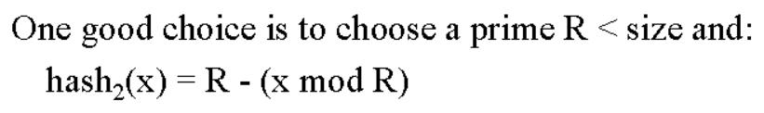
h(k,i) = (h₁(k) + i h₂(k)) mod 7
ℎ₁ 𝑘
ℎ₂ 𝑘
= 𝑘%7,
= 5 − (𝑘%5)
keys: 76, 40, 47, 55, 10, 93,
0 | 1 | 2 | 3 | 4 | 5 | 6
 | 47 | 93 | 10 | 55 | 40 | 76
Lecturer Saifur Rahman, Dept. of CSE, United International University

Slide 40


Consider an open-addressing hash table as shown below. The table already contains four data items. Assume that collisions are handled by the hash function
_{𝒉}′
𝒉(𝒌, 𝒊) = 𝒌 + 𝒊𝒉𝟐 𝒌 𝒎𝒐𝒅 𝟏𝟑, where 𝒉′(𝒌) = (𝟐𝒌 +
𝟕) 𝒎𝒐𝒅 𝟏𝟑 and 𝒉𝟐(𝒌) = (𝒌 + 𝟓) 𝒎𝒐𝒅 𝟏𝟑.
By showing calculations, redraw the table after
insert 90;
insert 83 What is collision?
Chaining vs Open Addressing; pros cons
Lecturer Saifur Rahman, Dept. of CSE, United International University

